Slide 1
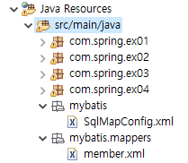
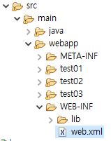
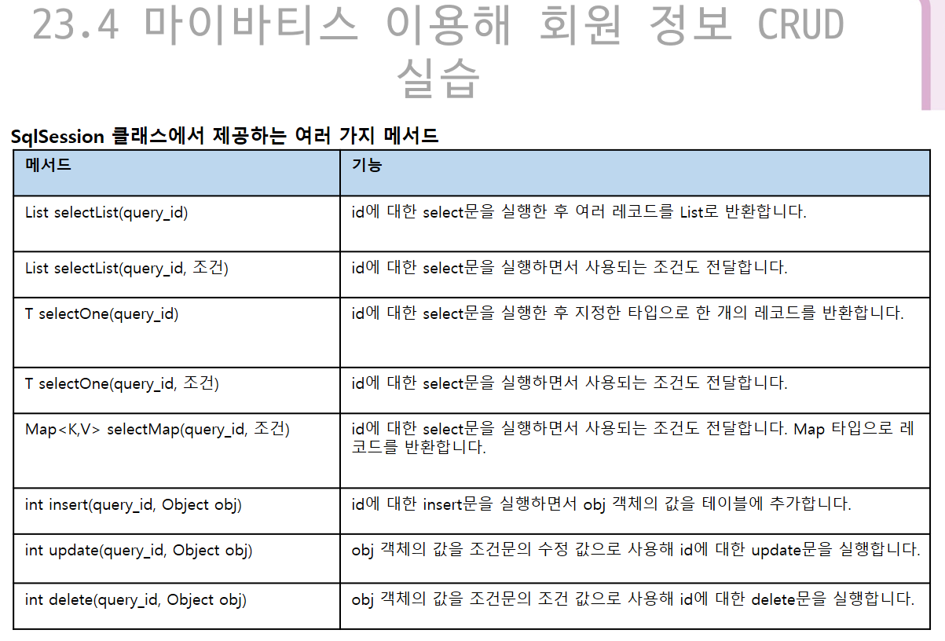
/mem.do
MemberServlet.java
에서 dao.selectAllMemberList()호출
MemberServlet.java
에서 결과를 DispatcherServlet으로 jsp에 forwarding함
MemberVO.java
….
….
….
MemberDAO.java
- SqlSessionFactory - Resource.getResourceAsReader(“mybatis.xml”) - SqlSessionFactoryBuilder()
- List<memberVO> selectAllMemberList(){ }
listMembers.jsp
….
….
….
….
SqlMapConfig.xml
Member.xml

